Slide 1

Class Visits: CCS 101, Business
Career Cruising: Anyone!
Credentials in FYE classes
Walk in Hours
One on one counseling advising career choice and path.
Graduation meetings
Alumni follow up
Website and Newsletter updates

Slide 2

Recurring Events
Resume Workshops : Various dates and formats including class visits and individual appointments
Interview Skills : Individual appointments
Career Interest Roundtables: Past careers include law enforcement, banking and finance, court services, health care. 1 or 2 a semester
Transfer and Internship Fair : October 30th
Mock Interviews: November 14th and March TBA
Career Fair: April

Slide 3
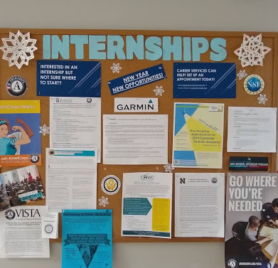
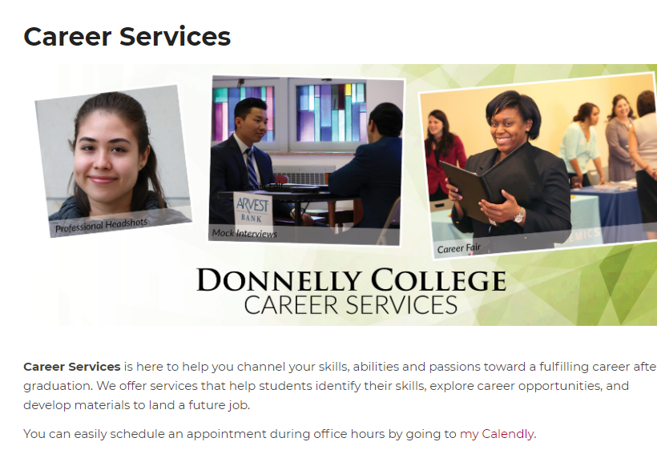
Resources for Job Searching
Job, internship, volunteer postings on boards
career services webpage

Slide 4
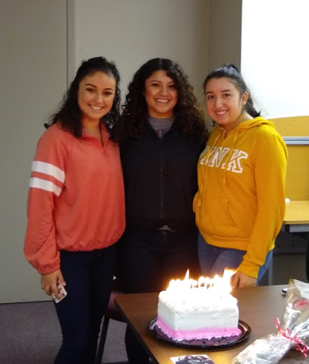
Testing Services
Make up testing or alternative testing environment.
Post-testing
Intake testing
Make up testing form on website at:
https://www.donnelly.edu/staff/files/documents/Make-up%20Testing%20Request%20Form%20Fall%202019.docx
Testing hours and information at:
https://www.donnelly.edu/students/testing

Slide 5
Conditional Admission
Students are placed by incoming scores
Enrolled in college classes with mandated support services
Enrolled in 1 hour support class
Required to attend tutoring 1 time weekly
Required to meet with their Academic Coach 5 times a semester.
Fall 18, 75% of students who began semester enrolled again in Spring 19
CCS 103
Mary Pflanz
Yvonne Telep

Slide 6
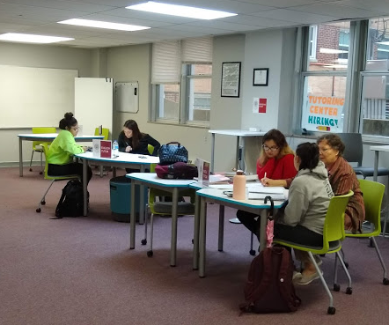
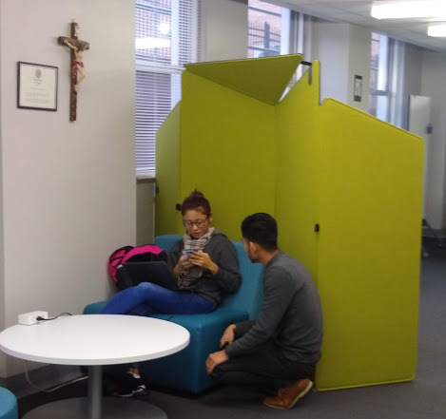
Study Spaces
Open Computer Lab
Quiet Study Room
Supported Study Room
Group Study Room

Slide 7
Donnelly Tutoring Center
Monday – Thursday 9AM -5PM
Friday 9AM -1PM
English and Math available every hour
Both walk in and appointments accepted
Peer tutoring model
Additional subjects available such as
Business
Public Speaking
Accounting
Biology
Chemistry
A & P
Supported Study Sessions in
Anatomy & Physiology
Biology
English Composition
If you have a need for tutoring or Supported Study Sessions, please speak to me about setting something up.
Coming in the future:
After hours tutoring
Powered by Zoom?

Slide 8
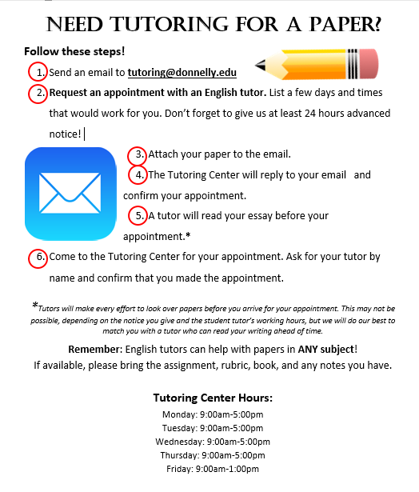
English tutors offer comprehensive help!
Encourage sending papers in advance
Strive for a learning experience
Not an “editing service”
Outlines, organization, understanding material, citations
The more we know about assignments the better
We help students with papers in any subject area
Tutors will visit classes if requested
Tutors will help with reading comprehension, understanding assignments, vocabulary, study skills, etc. Not just for paper edits!
This flyer has been widely distributed. If you want to share it with your class, I am happy to send an electronic copy, visit classes, etc.!

Slide 9
Usage and results AY 18/19
Careers Tutoring
31% of student population signed on to Career Cruising, with average study signing on 4 times in the year
22% of students attended our Career Fair
8% of students did a Mock Interview
65% of graduating students stated they had interacted with Career Services through counseling or an event in their time at Donnelly.
47% of Donnelly students visited tutoring, with 28% returning for 2 or more visits
100% of students answered Excellent or Very good when asked to rate the tutoring center on Atmosphere, Professionalism and Attitude.
88% answered Excellent or Very good in the areas of Tutor Knowledge and Resources
Average GPA of regularly tutored students was .95 higher than that of untutored students.

Slide 10
Feedback in Words
I value the tutoring center so much. It has been crucial to my success in Math. I have also gotten excellent feedback on essays that have helped me maintain an A in Comp II.”
Tutoring is one of the best resources we have here at Donnelly. The tutors are always ready to help and with an amazing attitude.
“Tutoring is a great help.”
"This gives us knowledge about professional interviews. It helped me to be confident."
With the help of the Career Center at Donnelly College I was able to make a resume that would work for me and be prepared for the Interviews by having practiced multiple mock interviews.
I enjoyed meeting and speaking with students. I hope that I can do this again in the future.
Students should conduct a little more research about the position.

Slide 11
Use of Spaces This Semester
448 visits to the Quiet Study Room : This is already over 100 visit increase over ALL of Spring 2019 semester.
20 Students enrolled in STEM Fitness : Same number : This is already more than the number of students that signed up in all of Fall 2018
Group Study room has a study group with a standing appointment weekly! Other students utilize this room and Supported Study space for groups and pair studying.
269 students have signed in to Tutoring this semester, and a steady group has formed for the Supported Study in English. Numbers for the fall are far outpacing our Spring 19 numbers.

