Slide 1
Mission Office

Slide 2
Mission Office
The Office of Mission advances the Catholic identity, Benedictine charism, and diocesan heritage of Donnelly College and seeks to integrate the College’s mission into its academic programs and institutional operations and practices. Working with the President’s Office and in collaboration with other departments, the Mission Office forms students, faculty, staff, leadership, and alumni in the foundational mission and identity of the College.

Slide 3
Mission Office
As a Benedictine and diocesan college, Donnelly offers a unique vision of Catholic higher education. The Mission Office ensures institutional fidelity to this vision and the Catholic Church’s vision of higher education in Ex Corde Ecclesiae and the Application of Ex Corde Ecclesiae for the United States. Through joyful fidelity, the Mission Office stewards the Catholic intellectual tradition upon which the College was founded and promotes the sacramental, liturgical, and spiritual life within which such a tradition can flourish with the goal of cultivating a Catholic culture both within the College and beyond its doors.

Slide 4
Donnelly’s Mission, Vision, and Values
Mission
Donnelly College is a Catholic institution of higher education that seeks to continue the mission of Jesus Christ in our time by making the love of God tangible in our world. Specifically, the mission of Donnelly College is to provide education and community services with personal concern for the needs and abilities of each student, especially those who might not otherwise be served.
Vision
The vision of Donnelly College is to advance the common good by being the most accessible and transformative Catholic College in the country.
Values
Truth, Community, and Excellence

Slide 5
Ex Corde Ecclesia (From the Heart of the Church)
Catholic Church
Catholic Higher Education
Donnelly College

Slide 6
Ex Corde Ecclesia (From the Heart of the Church)
Catholic Church
Ex Corde Ecclesia
Mission of Donnelly

Slide 7
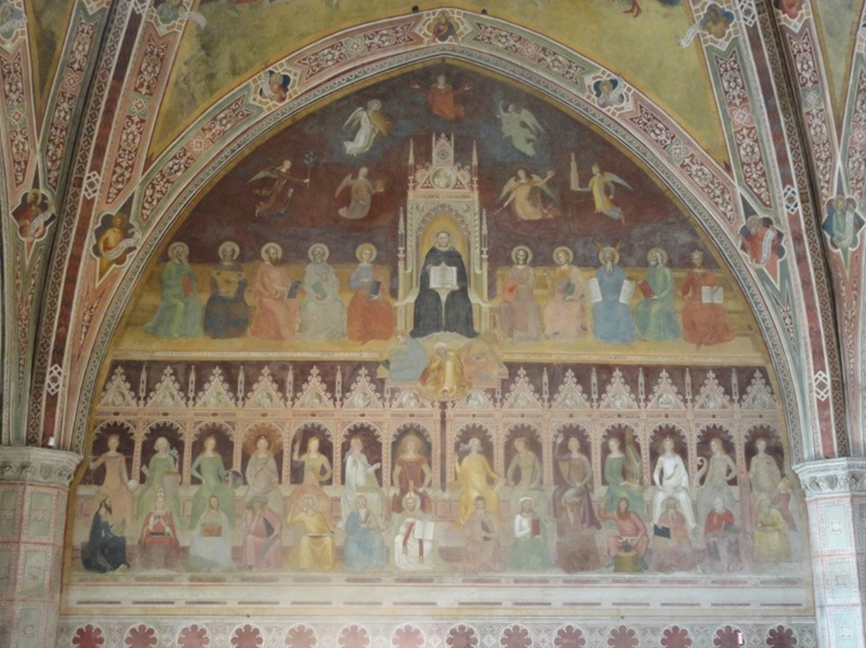
What is a Catholic college?
A Catholic university has to be a living union of individual organisms dedicated to the search for truth.
– Ex Corde Ecclesiae
Allegory of Christian Learning
Andrea de Bonaiuto
ca. 1366
And so, I prayed, and understanding was given me;
I entreated, and the spirit of Wisdom came to me.
I esteemed her more than scepters and thrones; compared with her, I held riches as nothing.
- Wisdom 7:7-8

Slide 8
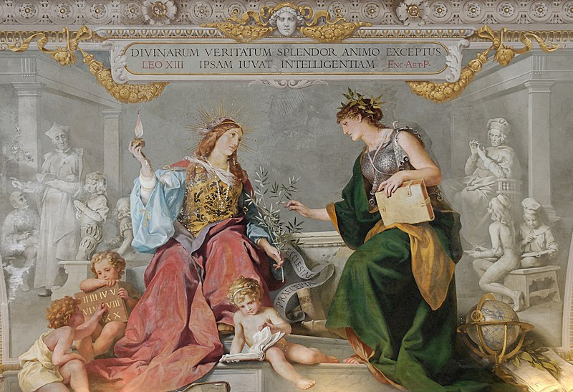
What is a Catholic college?
Faith and reason bear harmonious witness to the unity of all truth.
- Ex Corde Ecclesiae
Faith and Reason United
Ludwig Seitz, 1884
The splendor of the divine truths, received into the soul, helps the intellect.
- Thomas Aquinas

Slide 9
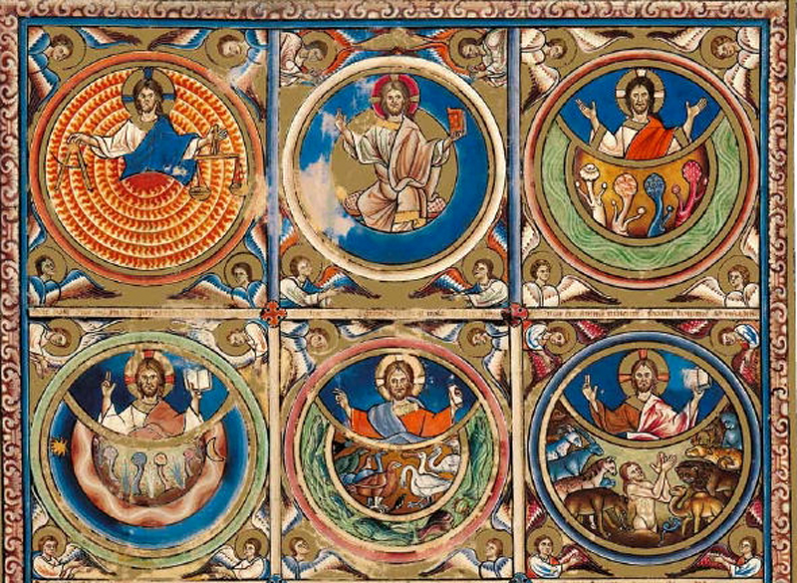
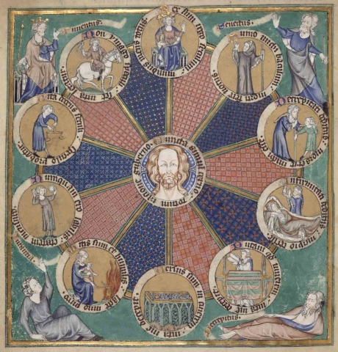
What is a Catholic college?
Christ, the Logos, is center of creation and of history.
- Ex Corde Ecclesia
Canterbury Psalter
ca. 1200
DeLisle Psalter
1339

Slide 10
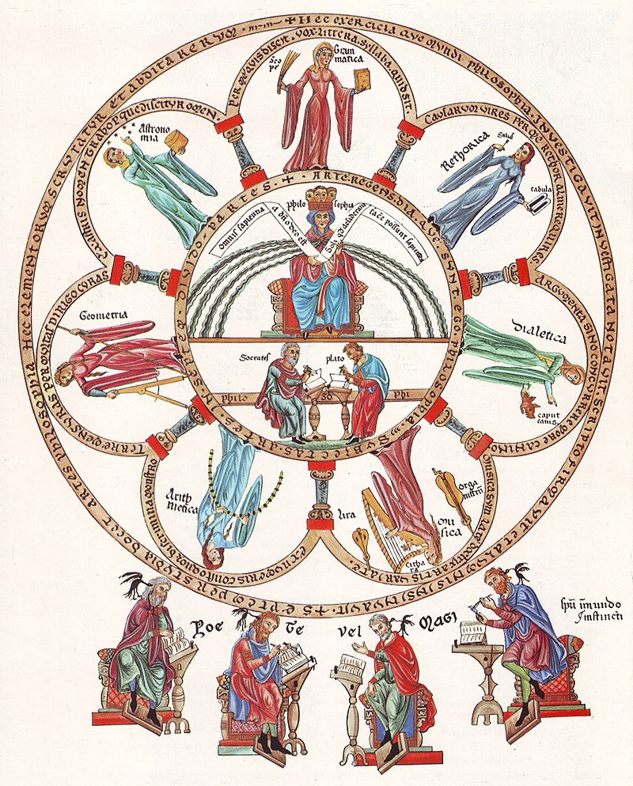
What is a Catholic college?
Philosophy
and the Liberal Arts
All wisdom comes from the Lord God; the wise alone achieve what they desire.
Without in any way neglecting the acquisition of useful knowledge, a Catholic University is distinguished by its free search for the whole truth about nature, man and God. - Ex Corde Ecclesiae
Herrad of Landsberg
abbess of Hohenburg ca. 1180

Slide 11
What is a Catholic college?
Theology serves all other disciplines in their search for meaning, not only by helping them to investigate how their discoveries will affect individuals and society but also by bringing a perspective and an orientation not contained within their own methodologies.
- Ex Corde Ecclesiae
Physical Sciences
Natural Sciences
Math
Philosophy
Nursing
Fine Arts
Theology
IS/
Business
Language Arts
Social Sciences
History

Slide 12
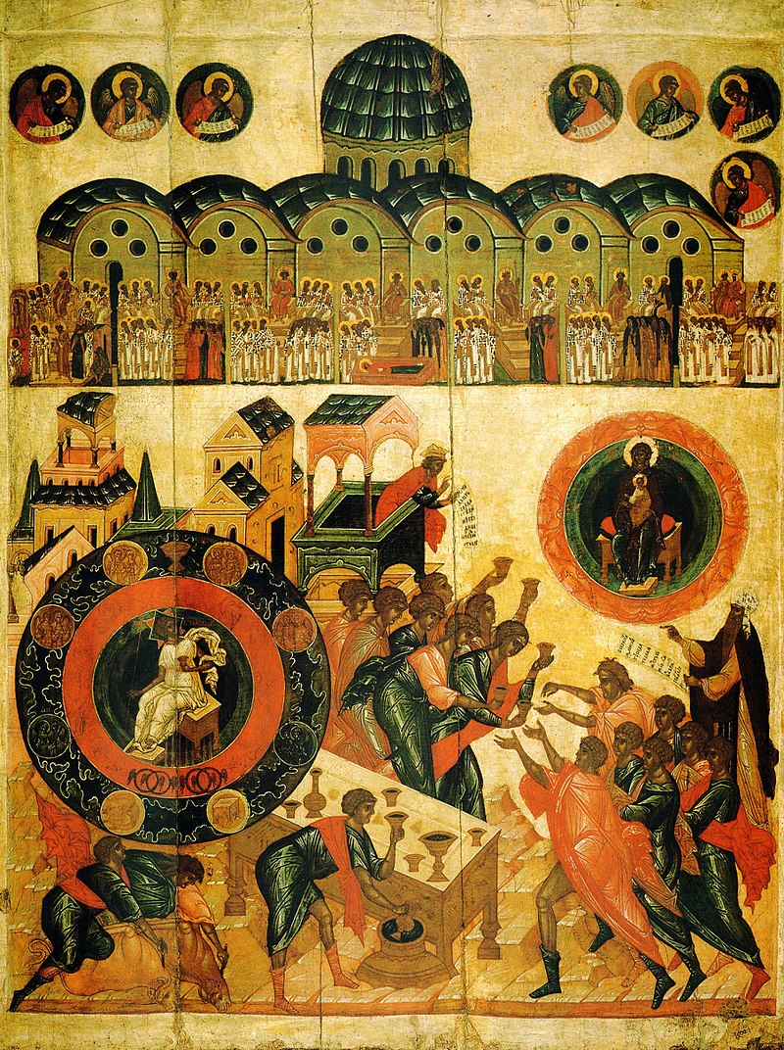
What is a Catholic college?
By means of a kind of universal humanism a Catholic university is completely dedicated to the research of all aspects of truth in their essential connection with the supreme Truth, who is God…and who alone is capable of giving fully that Wisdom without which the future of the world would be in danger. – Ex Corde Ecclesiae
Divine Wisdom ca. 1500

Slide 13
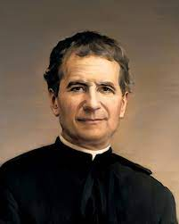
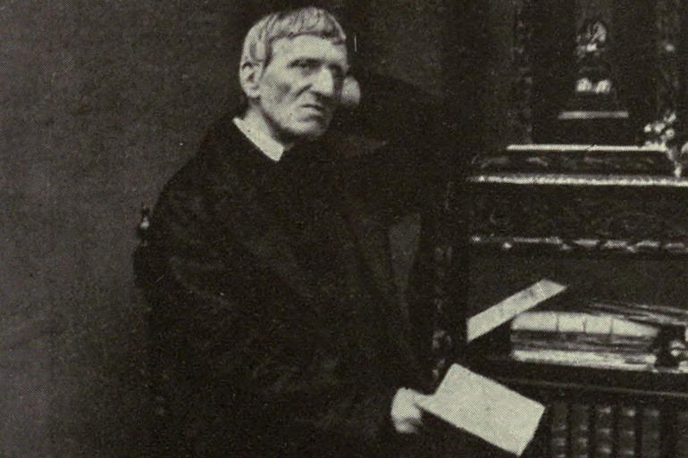
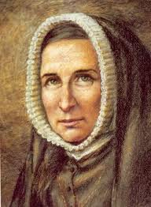
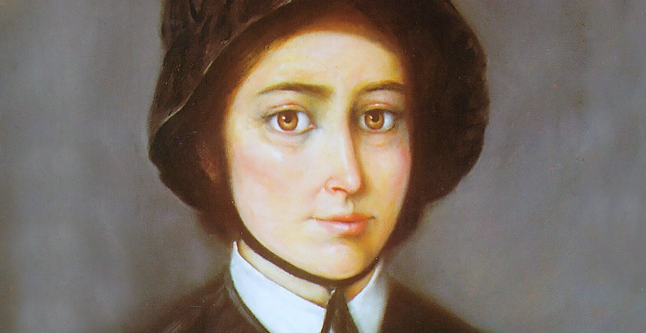
Those who might not otherwise be served

Slide 14
Those who might not otherwise be served
St. John Bosco
St. John Henry Newman
St. Rose Philippine Duchesne
St. Elizabeth Ann Seton

Slide 15
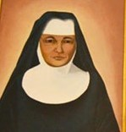
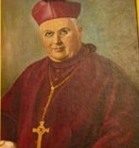
Those who might not otherwise be served

Slide 16
Those who might not otherwise be served
Sr. Jerome Keeler
Bp. George Donnelly

Slide 17
Core Goals of the Mission Office
Formation in the mission: do you know Donnelly’s story and the Catholic vision of higher education?
Integration of the mission: how is this story and vision integrated into your department’s structures and practices?
Stewardship of the Catholic intellectual tradition: how are we sharing and passing on the Catholic intellectual tradition to our students and others?
Living the Catholic faith on campus: how are we living the faith on campus?

Slide 18
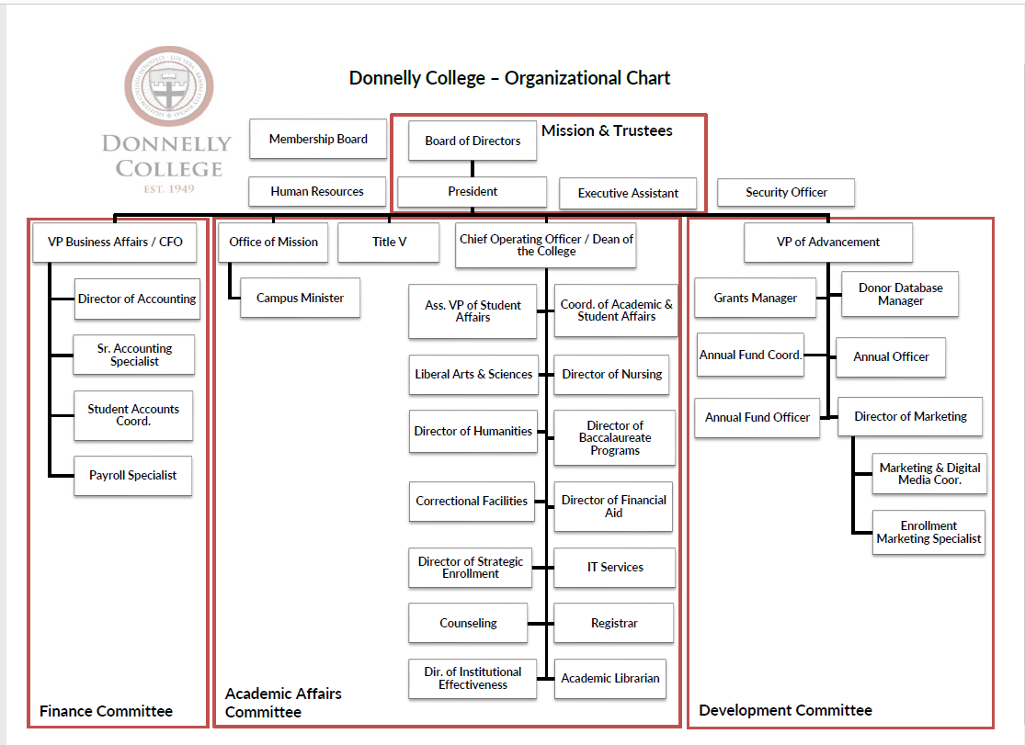
Mission Office

