Slide 1
Excellence through Assessment Year Two – What to do with all that data?
January 22, 2019
Lisa Stoothoff
Acting Vice President of Academic and Student Affairs

Slide 2
Assessment Philosophy
Donnelly College’s assessment framework has been designed to promote continuous program improvement. The faculty, staff, and students of Donnelly College recognize that program improvement can come in many forms, but that without taking time to examine and critically reflect on programmatic and internal operations there will be little chance of making meaningful or significant changes.

Slide 3
What Is Assessment of Student Learning?
Assessment is a systematic collection and analysis of data to improve student learning. The assessment process collects and analyze data on whether students can demonstrate a set of knowledge and skills after completing a program of study. It informs curriculum and program improvements.

Slide 4
Nine Principles of Good Practice for Assessing Student Learning
The assessment of student learning begins with educational values.
Assessment is most effective when it reflects an understanding of learning as multidimensional, integrated, and revealed in performance over time.
Assessment works best when the programs it seeks to improve have clear, explicitly stated purposes.
Assessment requires attention to outcomes but also and equally to the experiences that lead to those outcomes.

Slide 5
Nine Principles of Good Practice for Assessing Student Learning
Assessment works best when it is ongoing not episodic.
Assessment fosters wider improvement when representatives from across the educational community are involved.
Assessment makes a difference when it begins with issues of use and illuminates questions that people really care about.
Assessment is most likely to lead to improvement when it is part of a larger set of conditions that promote change.
Through assessment, educators meet responsibilities to students and to the public.

Slide 6
Authors: Alexander W. Astin; Trudy W. Banta; K. Patricia Cross; Elaine El-Khawas; Peter T. Ewell; Pat Hutchings;​Theodore J. Marchese; Kay M. McClenney; Marcia Mentkowski; Margaret A. Miller; E. Thomas Moran; Barbara D. Wright. These principles were developed under the auspices of the AAHE Assessment Forum with support from the Fund for the Improvement of Post-Secondary Education with additional support for publication and dissemination from the Exxon​ Education Foundation. Copies may be made without restriction.​
​

Slide 7
HOW DONNELLY CHANGED THE CULTURE OF ASSESSMENT
Assessment Academy Summer 2017
Revision of Donnelly College Learning Outcomes(DCLO)
Creation of Program Learning Outcomes (PLO) for every Program and Student Learning Outcomes (SLO) for every course.
Development of Assessment Council of Donnelly College and Student Learning Outcomes Committee
Revised Program Review process with Program Review Template and Schedule of Reviews
Mapping of General Education Outcomes
Assessment Plans for every department
Implementation of Watermark software AMS/VIA
Assessment of Co-curricular activities
Continuous review of data for continuous improvement
Assessment Acadamy Summer 2019-Mid-Project report

Slide 8
Assessment
What to do with all that data?

Slide 9
Assessment Data and Analysis – Success First

Slide 10
Target Outcome #3: 80% of students that pass Reading and Writing Strategies (EN09) in fall 2016 will pass both English Composition I (EN 111) and either College and Career Success (CCS 100 – taken concurrently with EN09) or First Year Experience (CCS 101 – taken in spring 2017).
• Actual achievement: Of the 16 students that passed EN09 in fall, 2016, 13 (81%) passed both EN111 and either CCS 100 or CCS101, above our goal of 80%. Of the three students that did not pass both EN111 and either CCS100 or CCS101, one failed CCS100 as a Prep student but went on to pass EN111 and is scheduled to take CCS101 next semester. The other two students passed CCS101 but failed EN111. In addition, as mentioned above, all four of the ESL Prep students (100%) who passed EN09 and EAP 165 as Prep students went on to pass both EN111 and CCS101 in spring, 2017.
Explanation of results: We believe that the high levels of success that former Preparatory Education students go on to achieve in freshman-level courses is a strong indicator of the effectiveness of our program. To ensure that Prep students are as prepared as possible for these subsequent courses, we have changed our assessment procedure to more closely resemble Comp I assessments—namely, having students read an essay and then write a reflective essay analyzing and responding to what they’ve read.

Slide 11
Data Matters
“If you don’t measure it you won’t improve it.”
-Henry Ford

Slide 12
What assessment data do we currently use at Donnelly College?

Slide 13
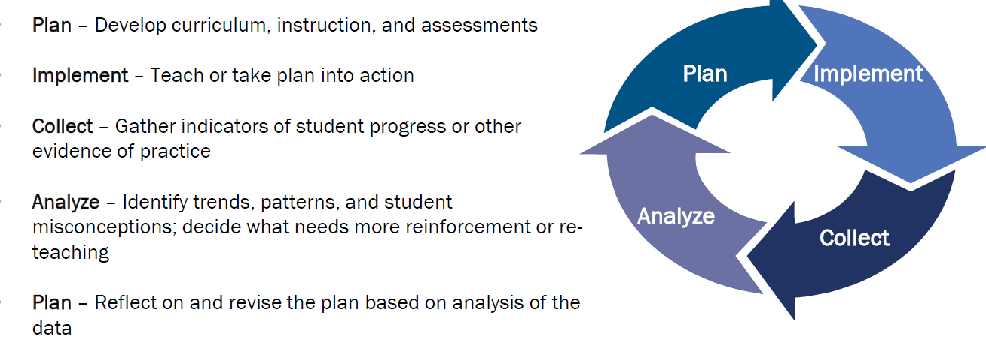

Slide 14
Aggregation of Data
Data aggregation is any process in which information is gathered and expressed in a summary form, for purposes such as statistical analysis.
#INSTITUTIONAL EFFECTIVENESS
#Graduation #Transfer #Engagement #Enrollment
#Performance #Retention #Program Changes #Student Success

Slide 15
Who decides what to do with the data?
Faculty makes course, book, delivery mode, time and Instructor changes
Staff makes co-curricular changes
Staff makes department changes
Program Director makes staff/program changes
Curriculum Committee makes (you guessed it!)
SLOC makes PLO, SLO, changes
ACDC makes systematic program changes
VPASA makes academic and student departmental changes
Cabinet makes Institutional changes

Slide 16
Where is the data stored?
AMS-Accountability Management System
https://www.taskstream.com/Main/homeCIP/default.asp
Via
Sharepoint

Slide 17
What changes have we already made with assessment data?
Discontinuing the Urban Teacher Education Program and instead focusing on our Education 2+2 articulation agreements (Program review data)
Revised the Intensive English program to be inclusive and hired a FT faculty (Program review data)
Reconfiguration of Administrative offices/Student Support services offices to better meet the needs of the students (Student surveys)
Addition of Campus Ministry activities, changed mass times (Campus Ministry surveys)

Slide 18
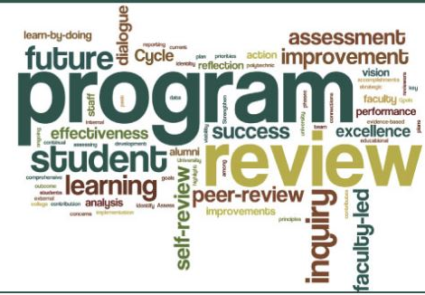
4B. The institution demonstrates a commitment to educational achievement and improvement through ongoing assessment of student learning.
The institution has clearly stated goals for student learning and effective processes for assessment of student learning and achievement of learning goals.
The institution assesses achievement of the learning outcomes that it claims for its curricular and co-curricular programs.
The institution uses the information gained from assessment to improve student learning.
The institution’s processes and methodologies to assess student learning reflect good practice, including the substantial participation of faculty and other instructional staff members.

Slide 19
Please fill out the evaluation form so I can assess this presentation!
Thank you for coming.

