Slide 1
SLO Day Spring 23

Slide 2
SLO Day Schedule
9 am Event center
Results of this academic year's data
Update on data from Fall 21 to Spring 22
Focus groups
11:30 am-12:30 pm break for lunch
Individual development plans

Slide 3
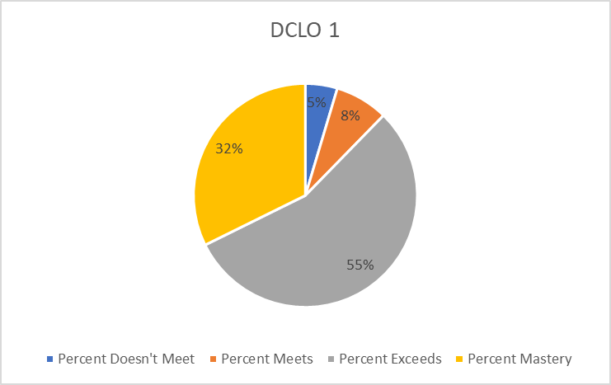
1. Communication Skills

Slide 4
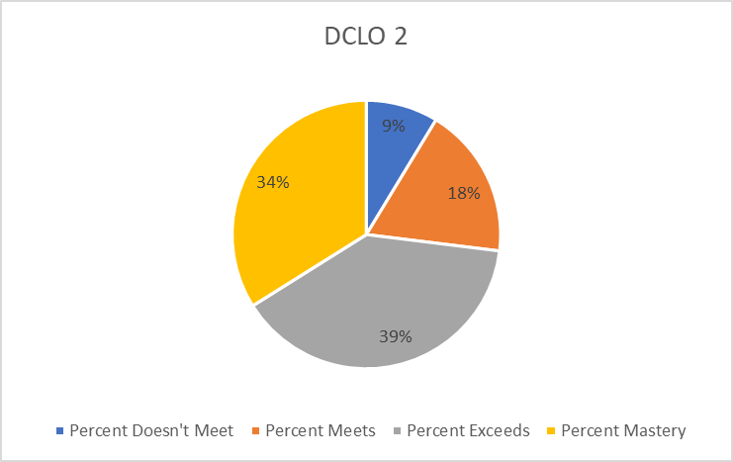
2. Technology and Information Literacy

Slide 5
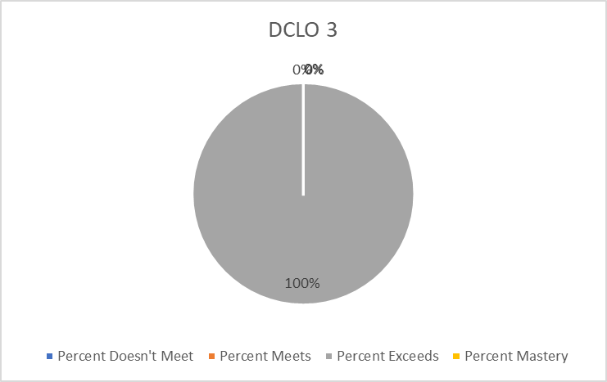
3. Symbolic Problem Solving

Slide 6
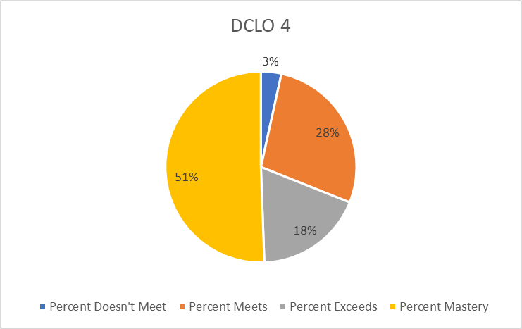
4. Analytical Thinking

Slide 7
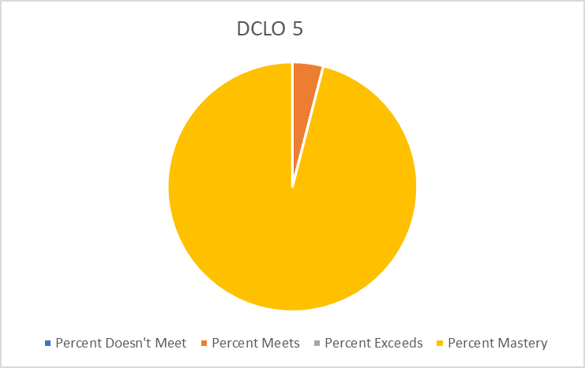
5. Personal and Interpersonal Skills

Slide 8
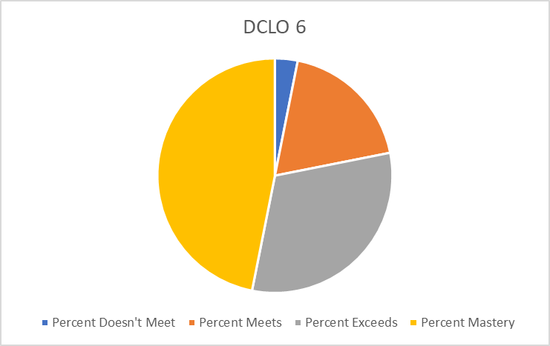
6. Academic Inquiry

Slide 9
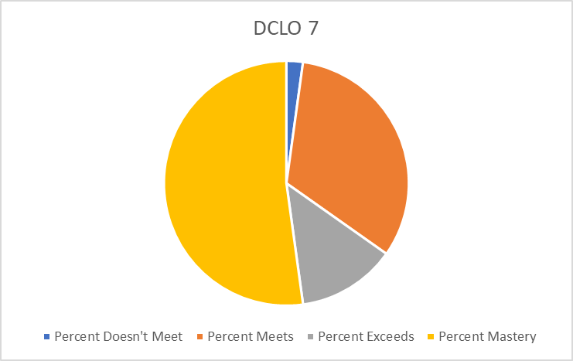
7. Values

Slide 10
Spring 23 Data
378 data points
2. Information Literacy
18 at Benchmark
53 at Milestone 1
13 at Milestone 2
0 at Capstone
7. Values
3 at Benchmark
10 at Milestone 1
8 at Milestone 2
0 at Capstone

