Slide 1
Serving Undocumented Students in higher ed
Webinar provided by Teman Training and Consulting

Slide 2
Introductions
A Brief History
House Keeping Items
Live Audio Broadcast
Recording Access
Live Q and A
Beyond Today

Slide 3
Today’s Agenda
Current state of policies on access
DACA now
Demographic Data and Resources
Facts on wages and job creation
Scholarship access and resources and Key Partner Organizations
Navigating employment options
College major choices
Training your team
Q and A session

Slide 4
Terminology Refresher
Visa Overstay
Out of Status
Undocumented
Undocumented DACA Recipient

Slide 5
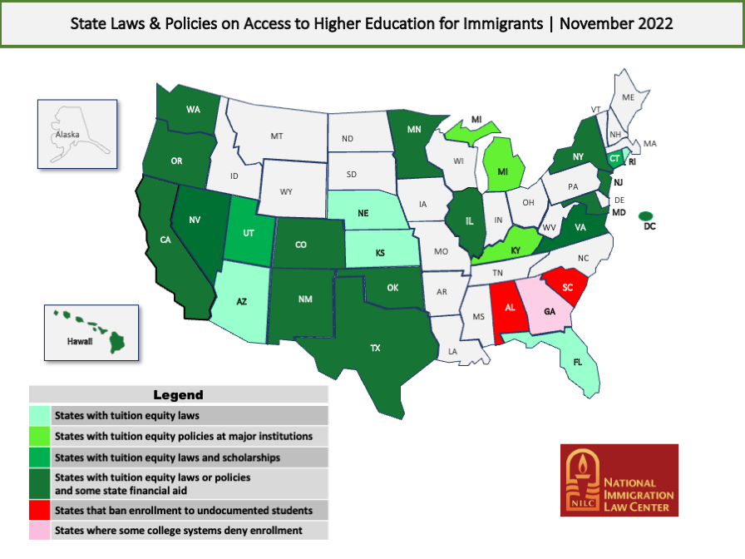

Slide 6
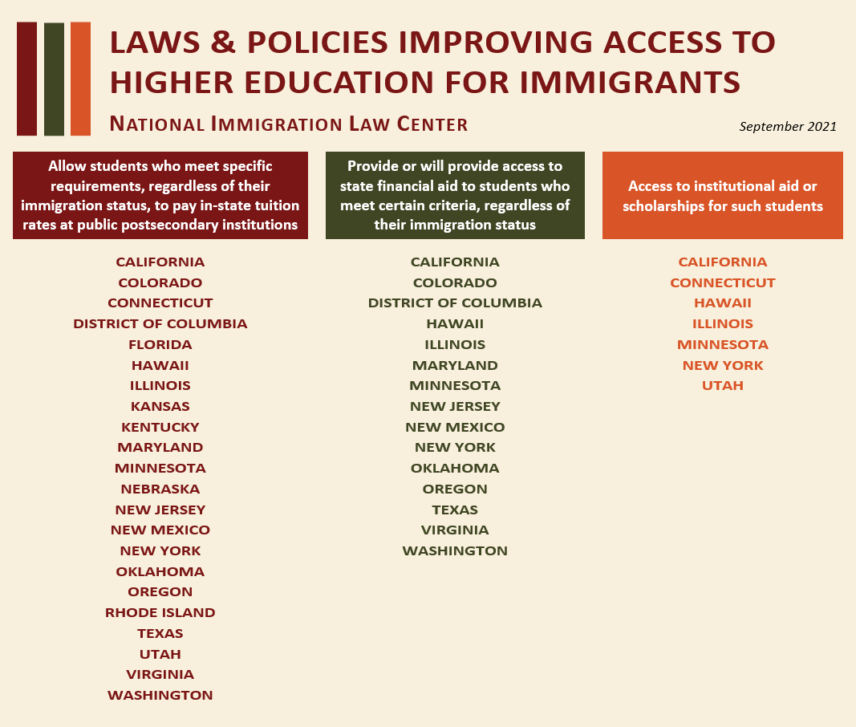

Slide 7
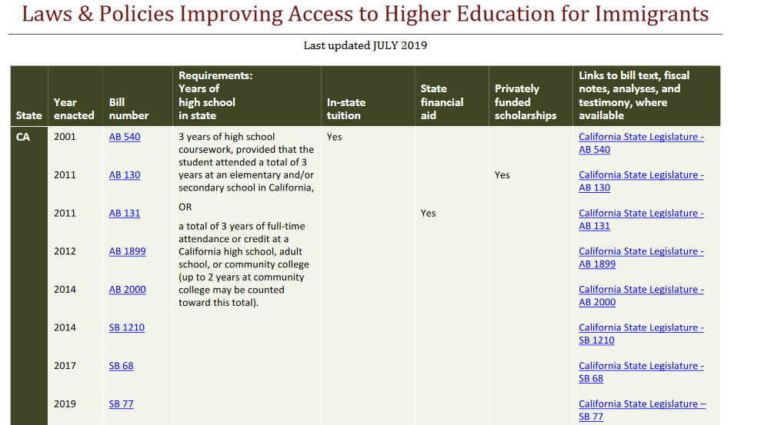
Keeping up with the Changes
Link:
https://www.nilc.org/issues/education/eduaccesstoolkit2a/#tables

Slide 8
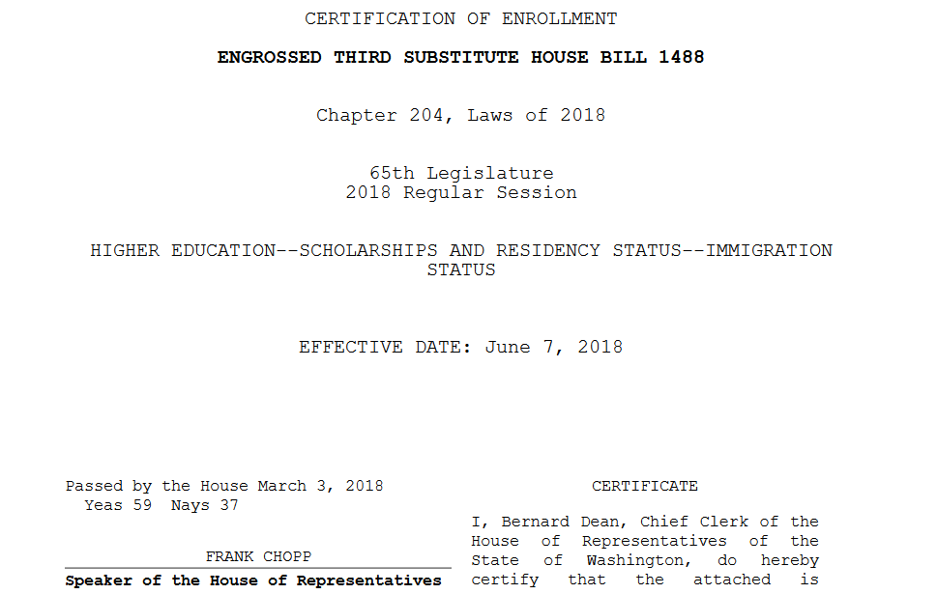
This resource allows you to view the legislation in regards to access at the state level.

Slide 9
General Key Points on the Federal end
FERPA –
For undocumented students who don’t possess student visas, the implication of FERPA is that there is no need or reason to disclose your immigration status and you can’t be made the subject of discrimination, intimidation, or deportation as a consequence of your desire to access to education.
Access to Education -
According to FEDERAL law, undocumented students are allowed to attend colleges and universities in the United States. There are no laws at the national level prohibiting undocumented students from seeking admission, enrolling in, or graduating from American colleges.

Slide 10
American Dream and Promise Act - 2021
American Dream and Promise Act –
New version passed by house in March 2021. Will Not be taken to vote in the Senate
Overview of proposed legislation:
The Department of Homeland Security (DHS) or the Department of Justice (DOJ) shall provide conditional permanent resident status for 10 years to a qualifying alien who entered the United States as a minor and (1) is deportable or inadmissible, (2) has deferred enforced departure (DED) status or temporary protected status (TPS), or (3) is the child of certain classes of nonimmigrants. The bill imposes various qualifying requirements, such as the alien being continuously physically present in the United States since January 1, 2021, passing a background check, and being enrolled in or having completed certain educational programs.

Slide 11
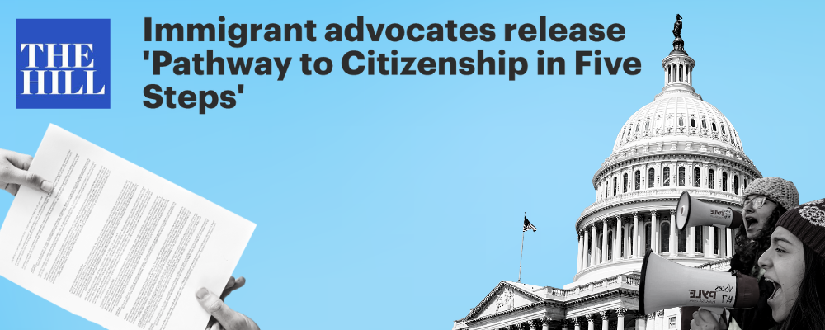
So, What now?

Slide 12
The DACA Program
Provides a lawful, but temporary status within the US
Executive order passed in 2012
Allows for work permits and easier access to benefits
Where it Stands Today
October 2022 Court Decision concludes DACA is unlawful
New applications will be accepted but the USCIS cannot approve them at this point
Renewals will still be processed and can now be done online
Those whose DACA is expired over 1 year ago, are considered new applicants

Slide 13
DACA Requirements
A person may qualify for DACA if they can show that they:
1)Were under 31 years of age as of June 15, 2012, when the DACA program was announced (i.e. the person was born after June 15, 1981)
2)Entered the United States before turning 16
3)Have continuously resided in the United States since June 15, 2007 up to the present
4)Were physically present in the United States on June 15, 2012, and at the time of making the request for DACA
5)Were undocumented as of June 15, 2012
6)Are currently enrolled in school, have graduated from high school, have obtained a certificate of completion, or are an honorably discharged veteran of the U.S. Coast Guard or U.S. Armed Forces
7)Have not been convicted (as an adult) of a felony offense, a significant misdemeanor offense, three or more non-significant misdemeanor offenses, or do not otherwise pose a threat to national security or public safety.

Slide 14
Applying for daca
Application for DACA requires submission of 3 forms:
I-821D – Consideration for Deferred Action for Childhood Arrivals
I-765 – Work Authorization Application
I-765WS – Worksheet for I-765
Fees total $495.00 and cannot be waived
All up to date forms can be found on the USCIS.gov website and should be downloaded when application is ready to be made.
Refer to the USCIS website for all required supplemental documents for filing.

Slide 15
Advance Parole
Advance Parole (AP) is permission granted by the Department of Homeland Security allowing certain noncitizens to temporarily travel outside the U.S. and return lawfully.
You must have a current, valid DACA grant, employment authorization document, and passport from your country of citizenship.
Reasons for Travel:
• Education: study abroad programs, academic research, student athlete travelling to participate in sporting events • Employment: overseas work assignments, conferences, interviews, trainings, or client meetings • Humanitarian: attending a funeral, visiting an ailing relative, or seeking medical treatment

Slide 16
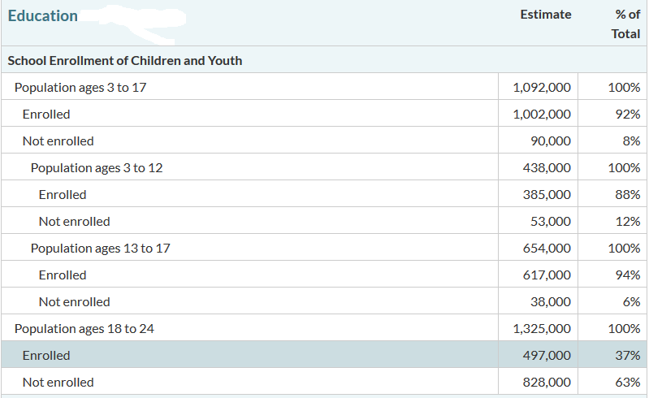
Educational Demographics

Slide 17
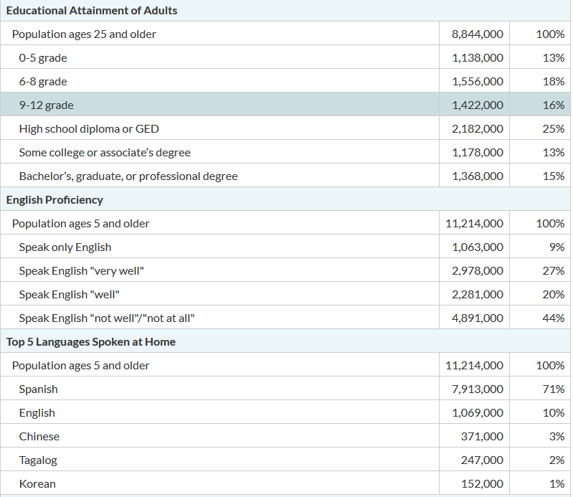
Educational Demographics
Average for US Citizens – 33.4%

Slide 18
Facts of Wage and Job Creation
The National Academies of Sciences, Engineering and Medicine show that the passing of a bipartisan immigration act like the Dream Act could bring up to 470,000 immigrant entrepreneurs into the economy with the potential production of 5.7 million jobs.
Undocumented Immigrants contribute an average of 8% of their income to taxes. This average then accounts to $80,000 more in taxes paid in than services used in a lifetime.
With the fees obtained by DACA applications, the program has cost taxpayers ZERO. Complete elimination of the program would reduce the GDP by 433 billion over 10 years.

Slide 19
Scholarships and access
Without access to Federal Financial Aid, providing multiple resources for scholarships is a way to reduce one of the main burdens of access…finances.
The following resources provide nationwide scholarship opportunities for undocumented students, remember to also look locally.

Slide 20
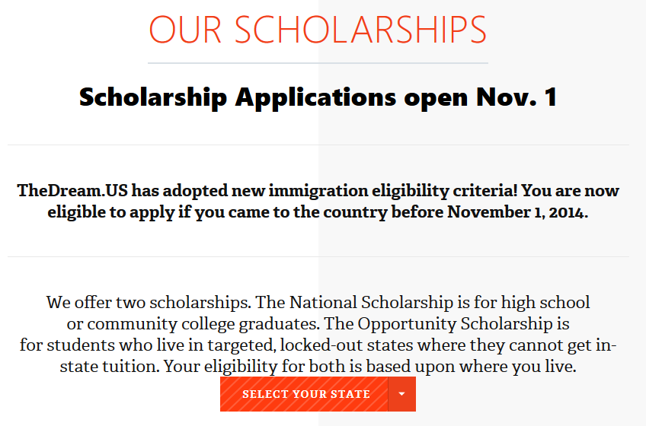
TheDream.us

Slide 21
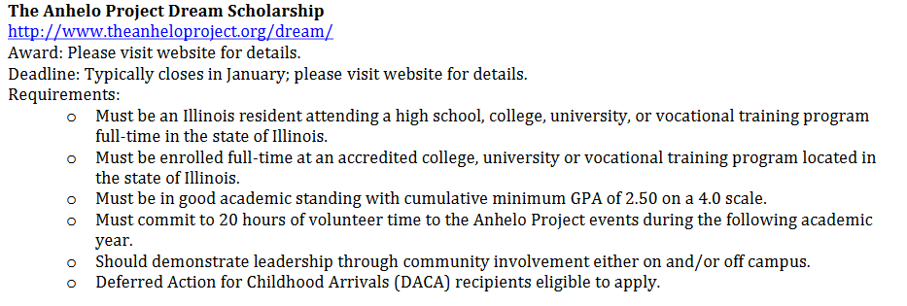
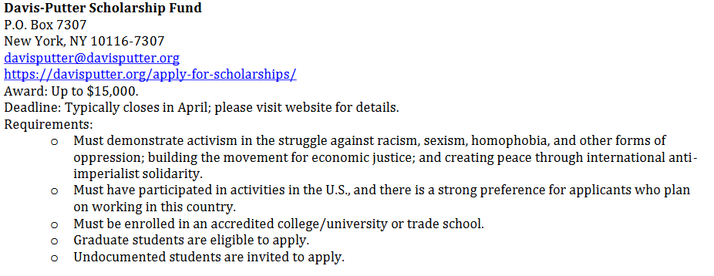
MALDEF Scholarship Resource Guide
https://www.maldef.org/resources/scholarship-resource-guide-2022-2023/

Slide 22
Connect your Students
The following organizations may be key resources for both your student and you:
https://unitedwedream.org
https://genprogress.org/
https://immigrantsrising.org/
https://mydocumentedlife.org/
These resources can keep you and your students up to date on changes in immigration law, advocacy, employment information, and scholarship resources.

Slide 23
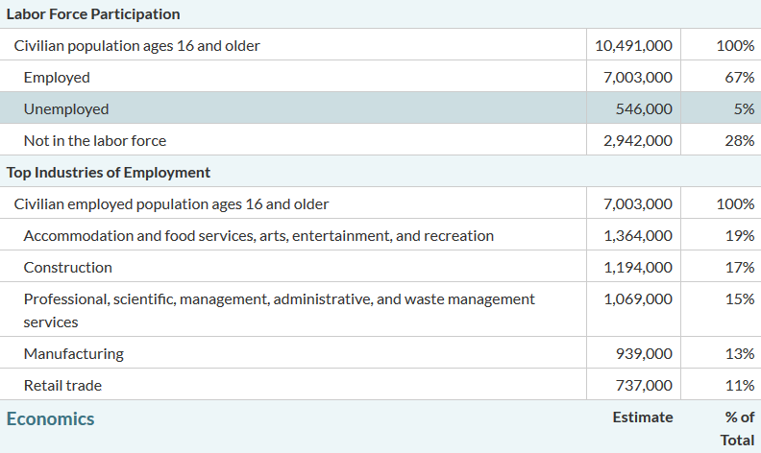
Employment

Slide 24
Employment
Aside from valid DACA recipients, undocumented immigrants are not legally permitted to work for an employer in the United States. The I-9 verification process is in place to attempt to prevent hiring.
Certainly this does not prevent undocumented immigrants from pursuing employment, but does create enhanced risk for both employee and employer.
The Independent Contractor Loophole
Hundreds of thousands of American small businesses are owned by undocumented immigrants using independent contracting. Undocumented immigrants can file for an ITIN (Individual Taxpayer Identification Number) and provide services as well as pay taxes under the ITIN.
Companies that hire contract work are not required to verify contract employment through the I-9.

Slide 25
Employment – A fix is not even close
The issue surrounding employment has never really been fixed. The DACA program came the closest. The reality is, that current federal laws prevent employment of undocumented immigrants. Despite the slight loopholes, employment is still one of the most difficult issues to tackle.
The Immigration Reform and Control Act provides for serious employer penalties. This all being said, undocumented immigrants are still working in many industries throughout the US.
The unfortunate fact is that the lack of change to address this issue at the federal level creates the need for undocumented immigrants to use a variety of tactics to support their families.

Slide 26
Choosing the College Major
Assisting an undocumented student with choosing a college major is one of the more difficult tasks we may take on.
Being truthful about future prospects of employment combined with providing a sense of realism for the student is important
The unfortunate fact is that some majors may not be the best choice for students
We cannot prevent most students from engaging in certain majors with the hope of legislative change, but we have to present the current state of their post-graduate options

Slide 27
Majors to Caution Students on
Programs that require a board certification or licensure exam
Programs that have mandatory co-ops or internships that require employment verification through the partnership
Programs that require background checks
Programs that may have very limited employment options utilizing independent contracting as an option

Slide 28
Majors to consider
Programs that lead to a student to potential entrepreneurship
Fields that may be considering independent contractor friendly: consulting, information technology, construction management, training and education, and a variety of others
Remember to pay attention to DACA and its future as it may strongly impact major choice for students

Slide 29
So…What Now?
Knowledge of the truths of this subject is your biggest ally. The best thing we can do to start is to educate our campus community. Understanding the issue is the only true way to combat it.
Train your team as much as possible
Engage your campus with workshops for both you academic and non-academic faculty and staff
Remember, a campus that speaks the language of truth on this subject is the campus that begins to provide the best service to undocumented students
Build your menu…resources, scholarships, employment, etc…
Learn to learn…know the resources to refer to
Be a proponent of positive change

Slide 30
Ways to train your team
Make it part of the employee on-boarding process
Provide quarterly “Lunch and Learn” sessions for your campus
Invite them to participate in trainings like today
Make it a part of your campus professional development opportunities
Create a newsletter and distribute to your campus

Slide 31
Where to start?
The process of enhancing your services begins with community education on the topic
The complexity of this subject is not always the easiest to keep up with
Again, knowing your community demographics is crucial to making institutional decisions to move forward with a plan

Slide 32
Modify Scholarships
Review the requirements of your internal scholarships
Is what your asking for possible for an undocumented student to provide
FAFSA

Slide 33
How do we serve these students?
Safe space is crucial
Providing blanket knowledge to our community about the benefits available to undocumented students is the start
Families are crucial in the beginning phase and throughout
Abide by FERPA
Undocumented students are protected under FERPA just as our other students

Slide 34
Programming
Community Involvement
Understand your communities and engage
Off site informational sessions to funnel to campus
High School engagement
Partner with school counselors to promote informational family sessions
Initial contact may not be direct recruitment
The college and financial planning session is a good start
Bilingual Brochures for parents

Slide 35
Programming
Start small and let the word get out
Assess your pilot programs and implement needed change
Hard recruitment is…well hard
Utilize your off campus programming to promote visits to campus
Involve student organizations in on and off campus recruitment
Building trust by knowing your facts

Slide 36
Retention
Not unlike any other student…engagement with campus is key to retention
Train your team
Students affairs, faculty, athletics, advisors, career services etc…all should be educated on the ins and outs of working with undocumented students
Training sessions

Slide 37
Q and A and feedback
Thanks for joining me today, the Q and A session is now open. You can type your questions in the GoToWebinar question function on the toolbar.
Feedback via the question function or email is appreciated
You may contact me at any time after today
Chad Teman – 419-230-4798 or chad@temantraining.com

