Slide 1
Donnelly College Fall Workshop August 14, 2019
Partners In Inquiry

Slide 2
MASS
8:15am
St. Maximillian Kolbe
Officiant: Fr. John Melnick

Slide 3
Breakfast-8:45am-9:00am Welcome-Lisa Stoothoff VP Academic and Student Affairs

Slide 4
Notes:
Poll Title: One word to describe your summer https://www.polleverywhere.com/free_text_polls/TZQbsJQEx94EEUqOje5yJ

Slide 6
STAND UP, SIT DOWN: FINDING COMMONALITIES

Slide 7
Notes:
Poll Title: How many new full-time employees on staff since May, 2019? https://www.polleverywhere.com/multiple_choice_polls/GbAwioZD8NgDvxm5fLc3Q

Slide 8
Monsignor Stuart Swetland, President
Open Plenary

Slide 9
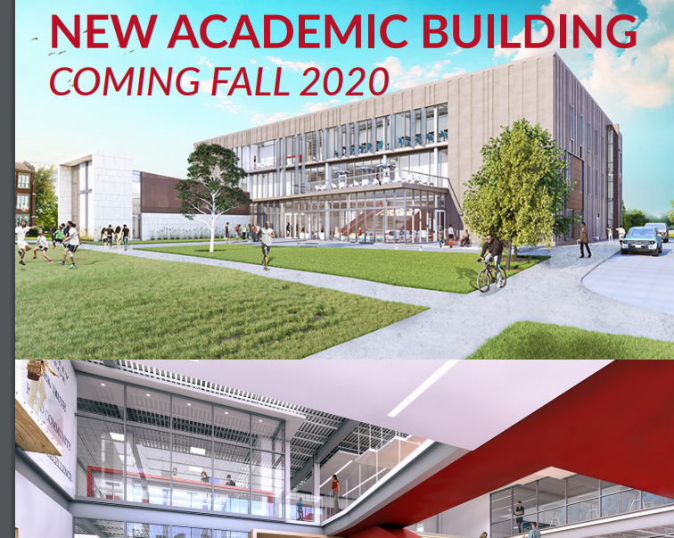
CHERYL HICKS, VP OF BUSINESS AFFAIRS

Slide 10
Introduction of New Staff-Department Heads
Advancement
Admissions
Student Support Services
Business Office/Financial Aid
Academic & Student Affairs
Nursing
Liberal Arts & Sciences
Baccalaureate Programs

Slide 11
Notes:
Poll Title: ONE WORD TO DESCRIBE THE NEW BUILDING https://www.polleverywhere.com/free_text_polls/nPI7wphzLpsSy2HcyhnZf

Slide 12
BREAK 10:15-10:30

Slide 13
GUEST SPEAKER
Rob Quillen

Slide 14
Notes:
Poll Title: What did you learn this morning? https://www.polleverywhere.com/discourses/OwyF6TqmOZijQS18Y3OnS

Slide 15
12:00-12:30
LUNCH
BIRTHDAY CELEBRATIONS

Slide 16
GRETCHEN MEINHARDT, DIRECTOR OF SUCCESS FIRST
SOCIAL JUSTICE TRIPS

Slide 17
TIME FOR FERPA!
JENNIFER BALES, DIRECTOR OF INSTITUTIONAL RESEARCH

Slide 18
WHAT'S NEW PUSSYCAT?
SPEED ROUND BY DEPARTMENT CHAIRS
(2 MINUTES)

Slide 19
BREAK 1:30-1:45pm
CAFFEINE AND CHOCOLATE

Slide 20
ASSESSMENT DAY:CLOSING THE LOOP

Slide 21
WORKSHOP ASSESSMENT
3:00pm

Slide 22
"FREE SPIRIT" HOUR
THANK YOU FOR PARTICIPATING IN THE WORKSHOP.

