Slide 1
Financial aid
Donnelly College
October 14, 2020
Mike Pepple and lauren Martin

Slide 2
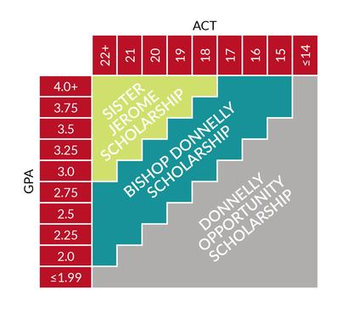
Recruitment
Scholarship update for 2020-2021
Removed scholarship deadline
Modified rules to empower admissions reps to talk finances with prospects
Streamlined awarding process – semi-automated
Created “Opportunity Scholarship”

Slide 3
Recruitment - FAFSA
Required for all students that are US citizens or Permanent Residents
EFC = Expected Family Contribution
FAFSA completion – TRIO
Importing ISIRs
Check for errors, c-codes, missing docs
Award Letters
Verification

Slide 4
Recruitment – DACA/Undocumented
Eligible for most merit scholarships
Require Institutional Aid form and tax/income information
FAFSA 4Caster used to determine “estimated EFC”
25%-50% Donnelly Grant
Award Letters

Slide 5
Enrollment
New Students
Initial award letters based on 12 hours
Adjust award letters once enrolled
Returning Students
FAFSA eligible students must complete a new FAFSA every school year
Nursing
Clearance Form signed by Financial Aid and Business Office
Must be completed to enroll

Slide 6
Enrollment
Enrollment Changes
Run add/drop report in Empower daily
Starting approximately 1 month before each semester
Through week 4 in Fall and Spring; Through week 2 in Summer
Changes in enrollment status cause drastic changes to eligibility
Tuition and Fee Changes

Slide 7
LOANS
Must be FAFSA eligible
Master Promissory Note and Entrance Counseling
Signed Award Letter to accept loans
Notification Letters with disbursements
SULA – Subsidized Usage Limit Applies
Wright International Student Services

Slide 8
Disbursements
Monitor attendance to ensure students have “earned” their federal aid
Non-attendance – cancel aid
Withdrawal – R2T4
Originations
Disbursements
COD
Business Office
G5

Slide 9
Grade Review
SAP
Completion percentage, GPA, Timeframe
Warning, Suspension
Notification
Appeals
R2T4
Review for errors
‘F’s = ‘W’s

Slide 10
Reporting
Annual
FISAP
IPEDS
Close-Outs
Master Disbursement Report
Monthly
Clearinghouse
Reconciliation – Pell and Loans
Ad Hoc
Endowment/Donor scholarship info
TRIO
KC Scholars
HDF
Bloch
Marketing

Slide 11
2nd Chance Pell
Lansing Correctional Facility
Pilot Year of Program
Classes begin this Fall
Opportunity to drastically increase enrollment (and revenue)
Challenges
FAFSA – Completion, dependent students, defaulted loans
Empower – manual adjustments

Slide 12
Other
Audit
Auditors “on campus” in June and September each year
Review federal aid – disbursements, verification, eligibility, R2T4, enrollment reporting
Confirm good work, identify areas for improvement
Work Study/Dragon Scholars
All positions filled
Monitor budget with HR
VA Benefits

Slide 13
conclusion

